Slide 1
Setup Guide
ICT283
for C++ Development

Slide 2
ICT283 Setup Guide for C++ Development
Introduction to C++
Minimum System Requirements
OS: Windows 10 and above
RAM: minimum 4GB of RAM
Hard Disk: minimum 50GB of hard disk memory

Slide 3
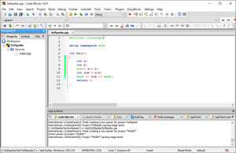

ICT283 Setup Guide for C++ Development
File Included
None
Introduction to C++
Install CodeBlocks IDE
Follow the installation guide in the link below.
Configure your IDE for C++ Development.
CodeBlocks- how to install and get started:
https://www3.ntu.edu.sg/home/ehchua/programming/howto/CodeBlocks_HowTo.html

Slide 4
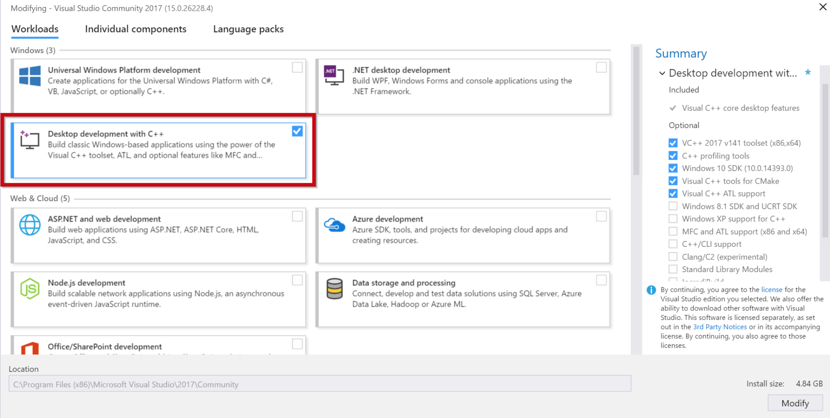
ICT283 Setup Guide for C++ Development
File Included
Introduction to C++
Install Visual Studio 2017 IDE (Optional¹)
Download and install Visual Studio 2017 community.
Select the “Desktop Development with C++” option.
For more information on Visual Studio visit:
https://docs.microsoft.com/en-us/cpp/build/vscpp-step-0-installation?view=vs-2019
vs_community__13132988.1488924318.exe
[1]
Not required for this course.
A very good alternative IDE, nonetheless. For those interested.

Slide 5
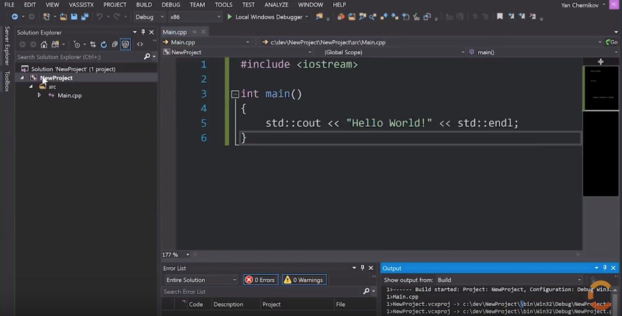
ICT283 Setup Guide for C++ Development
File Included
Introduction to C++
Setting up your VS projects (Optional¹)
Watch this video to learn how to setup a C++ project, organize your source code and store binaries and executables.
This will be your default project setup for all your work. Very important.
C++ Project Setup Tutorial: https://youtu.be/qeH9Xv_90KM
vs_community__13132988.1488924318.exe
[1]
Not required for this course.
A very good alternative IDE, nonetheless. For those interested.

Slide 6
ICT283 Setup Guide for C++ Development
Files Included
Introduction to C++
Install Doxygen (with Graphviz)
Install Doxygen with Graphviz plugin.
More information in this video tutorial: https://youtu.be/88THCy1vaUk
Doxygen is a program used to generate documentation for C++ projects (like Javadocs for Java code).
Doxygen relies on a special commenting syntax which you will learn later during this course.
It is important that you install and configure Doxygen correctly. Please read and understand all documents provided pertaining to Doxygen.
Graphviz is a Doxygen plug-in that is used to automatically generate UML class diagram visualizations inside your documentation.
In order for Graphviz to function properly, it is important that you know how to locate and change the environmental variables on your windows machine (See Video, 2:00).
doxygen-1.8.15-setup.exe
graphviz-2.38.msi
Configuring Doxygen.pdf
+
Configuring Graphviz.pdf

Slide 7
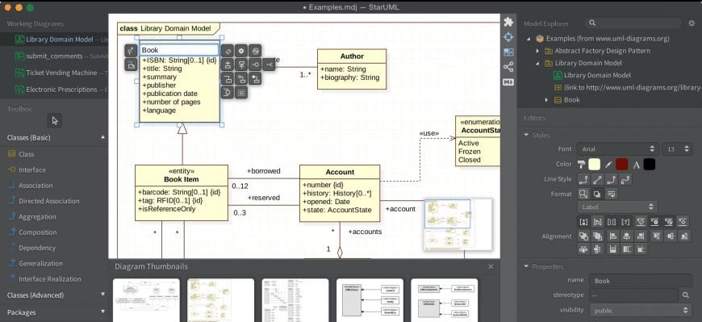
ICT283 Setup Guide for C++ Development
Files Included
Introduction to C++
Install StarUML
Install StarUML.
You will use StarUML to create UML class diagrams.
For a recap of UML notation visit: https://www.uml-diagrams.org/class-diagrams-overview.html
Watch this tutorial on creating class diagrams using StarUML: https://youtu.be/h5rZ7Hxsgkc (skip to 1:10).
staruml-5.0-with-cm.exe
StarUML Installation.pdf
+
Using UML.pdf

Slide 8
ICT283 Setup Guide for C++ Development
Introduction to C++
A Note to MAC and LINUX users
Not everybody is a windows user and that’s fine.
There are many ways to write and implement code so find your own configuration.
This course requires that you package your code in .cbp (CodeBlocks Project) files.
Also note that Doxygen runs only on windows.
You may use any other IDE that you prefer but do note that for ICT283 submissions, you will need to conform to the above requirements.

Slide 9
ICT283 Setup Guide for C++ Development
Recap
You should now have the following programs installed on your machine:
CodeBlocks
Visual Studio 2017 (Optional)
Doxygen (with Graphviz)
StarUML
Good luck and happy coding!
END ☺

